Slide 1
“Virtually all such studies find that low capital ratios raise the probability of bank failure.” BERGER, ROMAN 2020
Acharya & Mora (2015), JoF
Tirole & Farhi (2012), AER
Diamond & Dybvig (1983), JPE
Gonzales-Hermosillo 1999
Walther (2016), JMCB
Berger 1995, JMCB
Europe sovereign debt crisis
Tequila crisis
USA:Savings & loan crisis
Asian financial crisis
GFC
2014: Europa Single Resolution Board
1988 Basel I
2004 Basel II
2013 Basel III
1986
1990
1995
1997
2007
2013
Notes:
GONZALES’HERMOSILLO 1999

Slide 2
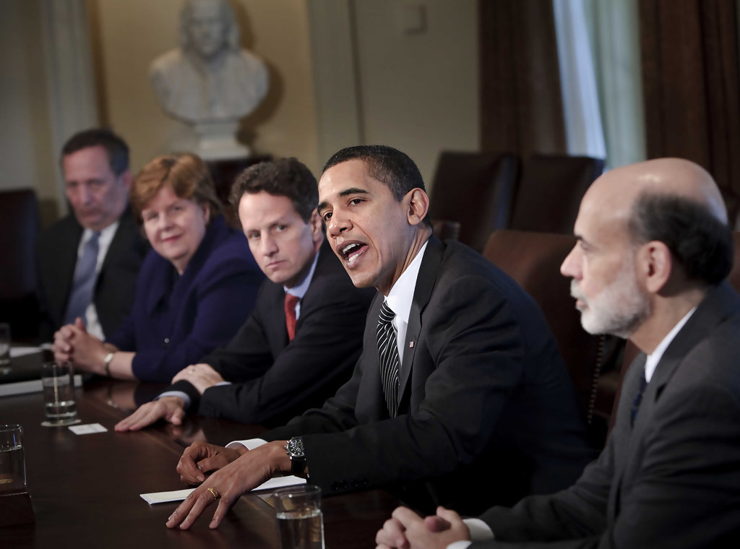
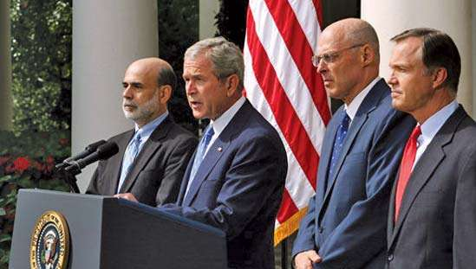

Bank failures
Payment system
Government
Aggregate supply
GFC
Diamond & Dybvig (1983), JPE
2007
Notes:
GONZALES’HERMOSILLO 1999

